Slide 1

Analysis of Wages in Colorado
Capstone Project
James Flanagin
jrflanagin@gmail.com

Slide 2
Contents
Introduction
Data Exploration
Colorado Datasets
Wages over time/MSA
Data Modeling
Supervised Learning
Unsupervised Learning
Assumptions and Limitations
Recommendations

Slide 3
Introduction

Slide 4
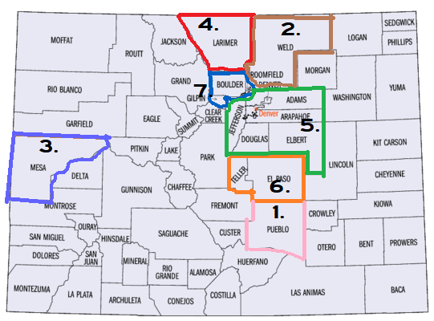
The main Metropolitan Statistical Area (MSA) which are defined by the CDLE:
1. Pueblo MSA (Pink)
2. Greeley MSA (Brown)
3. Grand Junction MSA (Purple)
4 Fort Collins-Loveland MSA (Red)
5. Denver - Aurora MSA (Green)
6. Colorado Springs MSA (Orange)
7. Boulder-Longmont MSA (Blue)

Slide 5
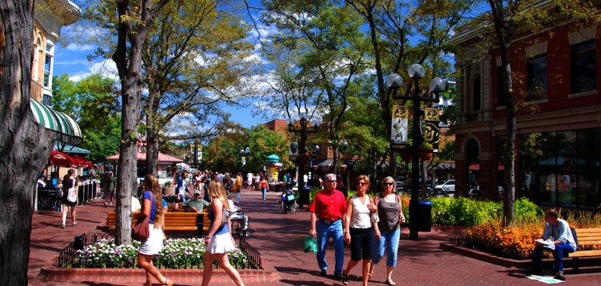
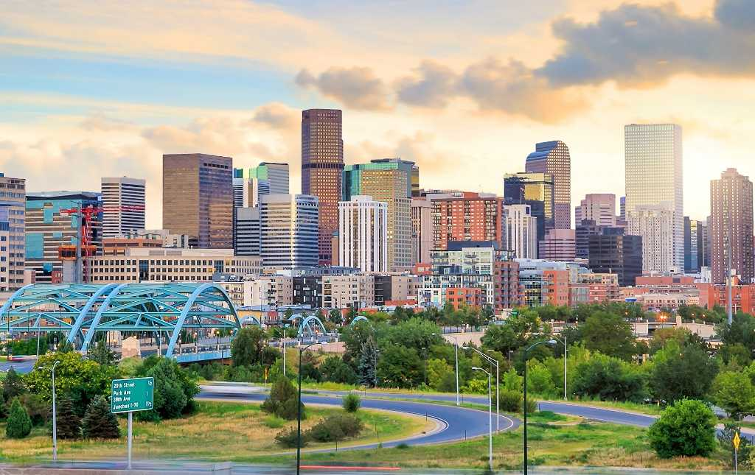
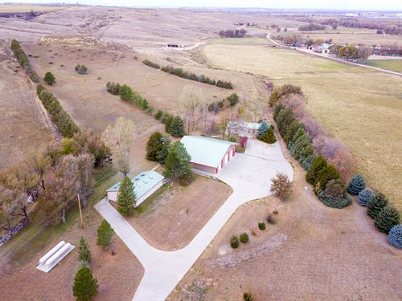
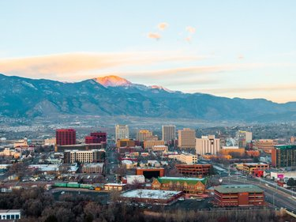
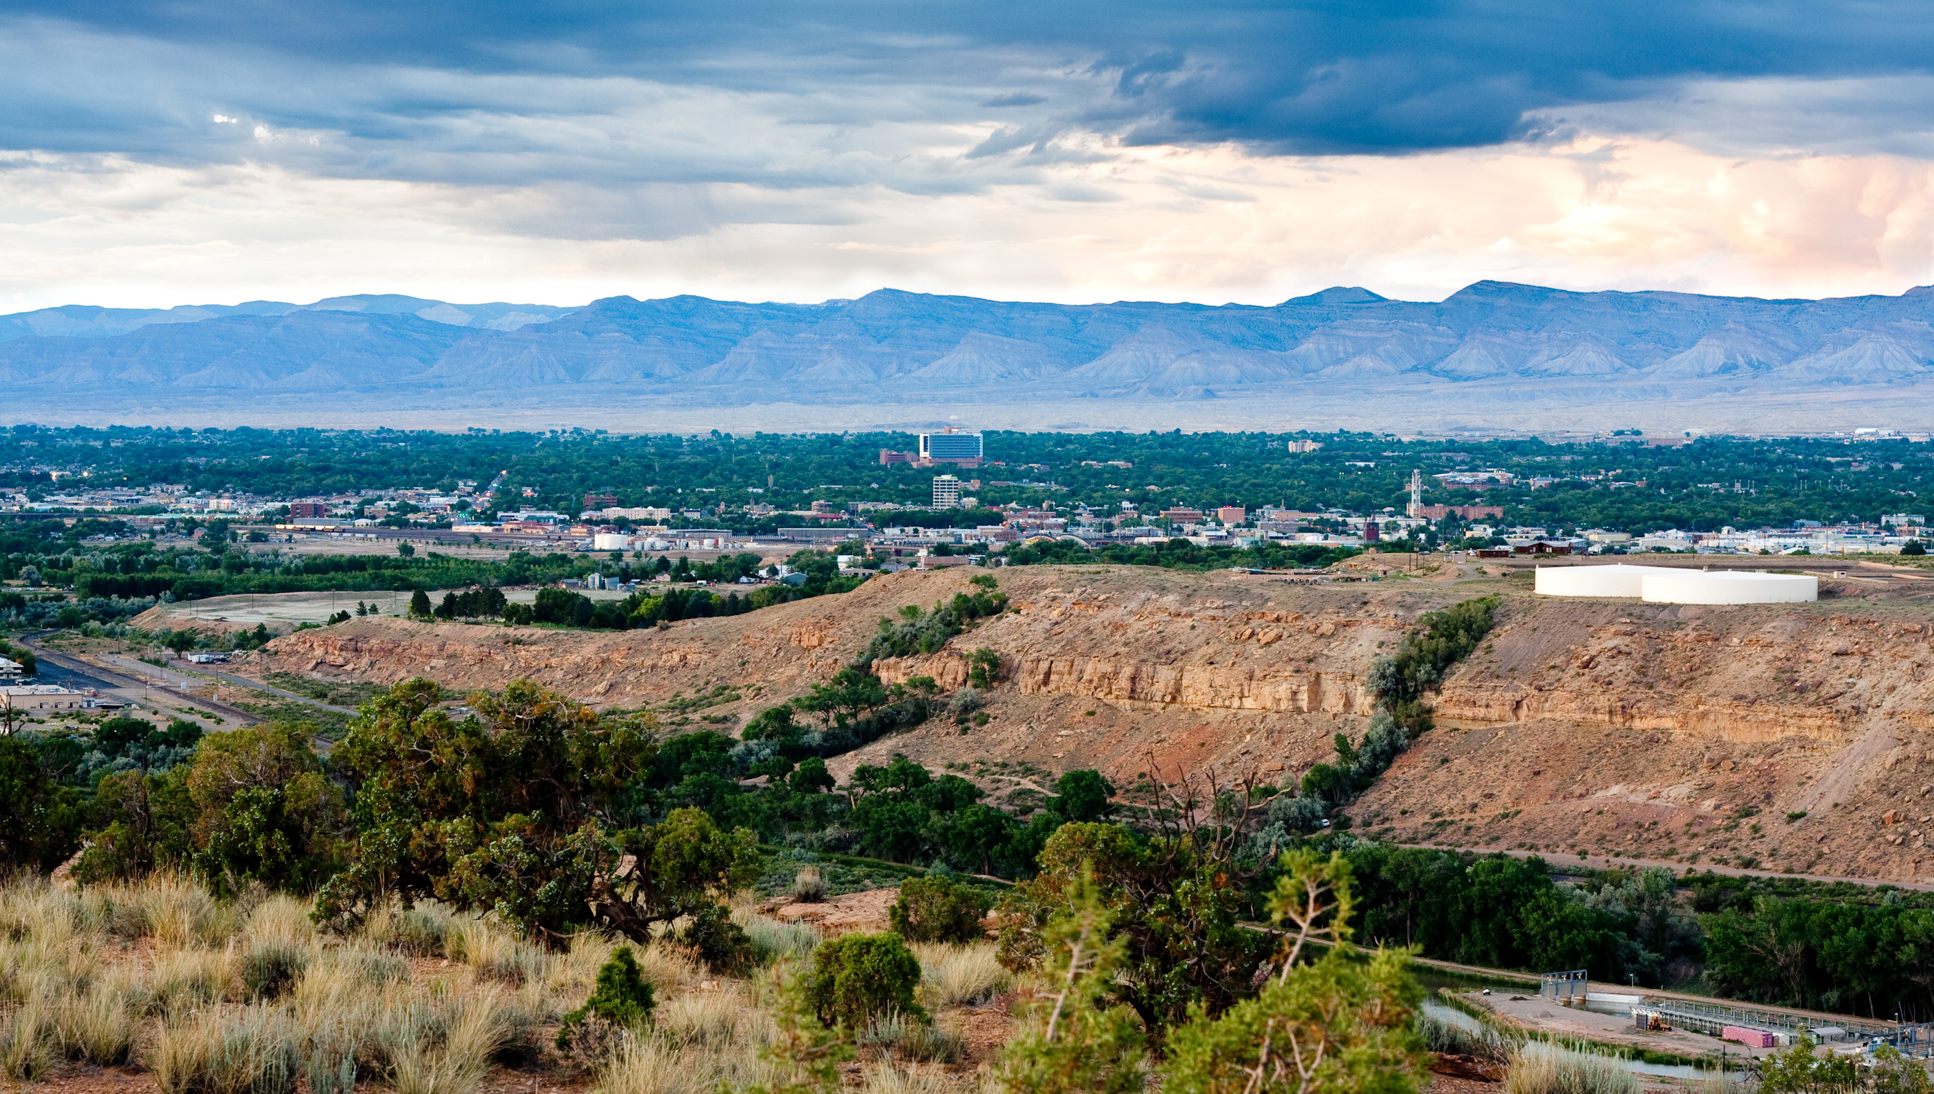

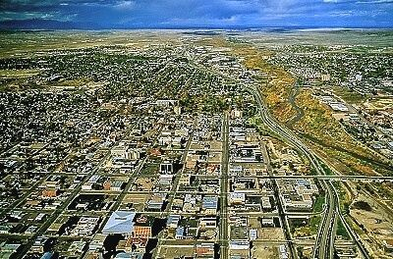
Every MSA diﬀers in demographics, wealth, and industry
Boulder- Longmont
Denver-Aurora
Greely
Colorado Springs
Grand Junction
Ft. Collins-Loveland
Pueblo

Slide 6

The Goal of the Study is to investigate how wages have changed as Colorado has grown in Population, and the opportunities that presents
Main Focus:
Total employment of an occupation and wage
Location and wage
Population and wage

Slide 7




The potential Clients that would be interested in this study
Business Owners
City Council
Students and recent grads
Developers

Slide 8
The Datasets used in analysis were
Employment wages by occupation, year, and area, from Colorado Department of Labor and Employment (CDLE), 2009-2015. 92.7k Rows, 40 Columns (CSV)
Annual population estimates for each year by county for the state of Colorado, from US Census Bureau, from 1900 to 2015 provided by the Colorado Department of Labor and Employment (CDLE). 3,082 Rows, 15 Columns (CSV)

Slide 9
All the data provided in separated ﬁles was merged into three data sets, that were cleaned and ﬁltered out for entries between 2009 and 2015
Employment Wages:
A good deal of redundancies and useless columns were dropped i.e panelcode,
any of the user defined columns were dropped as they presented conflicting information
Any duplicate and summarized information. In order to avoid assessing a sum vs it’s parts I dropped any row that contained summarized information. i.e State Totals, hourly wage vs annual salary.
After the Merge any descriptive data with one or few unique values ‘areatyname’, or any data that didn’t provide useful information eg. ‘indcodty’ was dropped
Population Data:
Any summary data was dropped. Colorado and US totals were removed and County based data was all that remained
Counties were grouped into their respective MSA
Dates were adjusted to line up with Wage data (2009-2015)
Columns that were useless were dropped. Population, periodyear and areaname were kept for merge purposes
All county based data was summarized to reflect the total population of each MSA
Only a portion of Colorado data is included in the major MSA’s. Counties not included were scrubbed.
2015 was missing data. Data was extrapolated based on the % change from prior year
Data was merged based on Areaname
The final shape of the data= 19598 rows × 13 columns

Slide 10
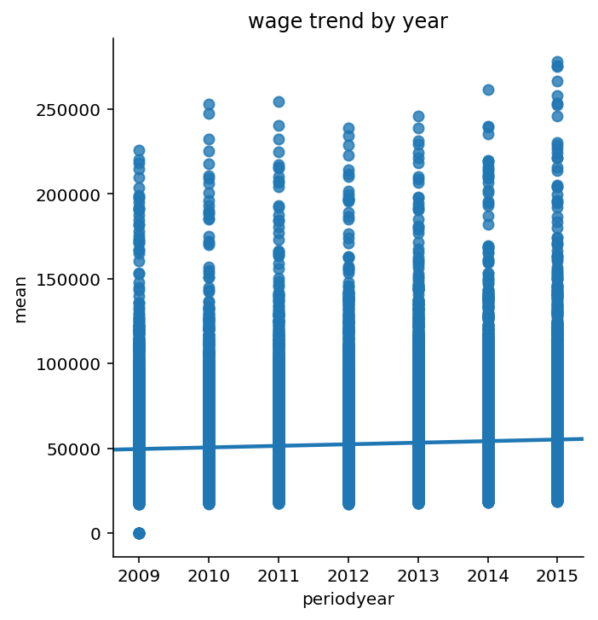
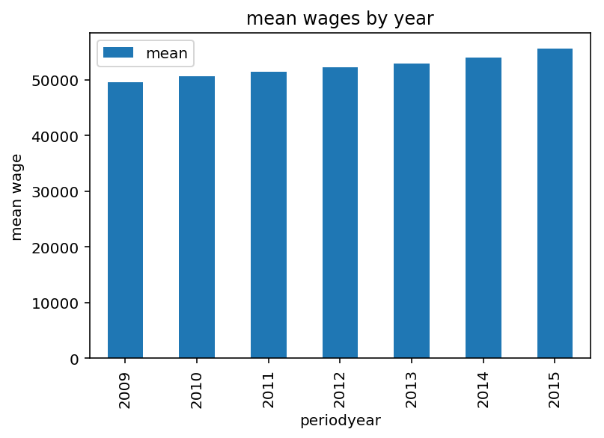
This shows that across Colorado mean wages have grow
Mean wages from 2009 recover from the recession across the board
There are a few less outliers in 2012 and 2013 but still indicates a positive trendline for the state

Slide 11
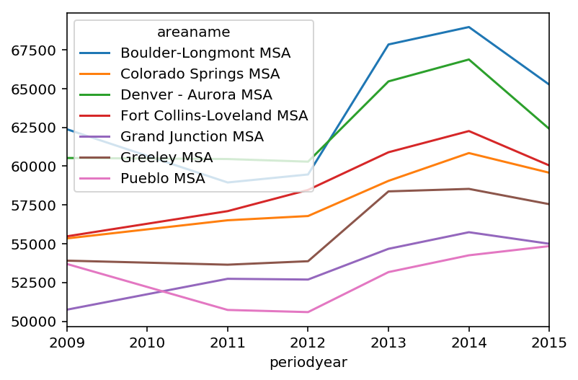
Mean revenue by MSA shows a clear leader with Boulder-Longmont

Slide 12
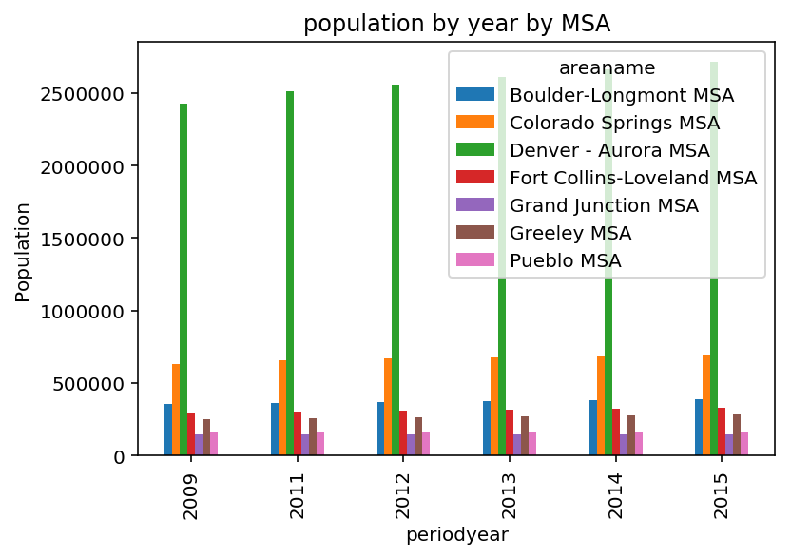
Despite the second highest mean wages Denver is far ahead the largest state by population

Slide 13
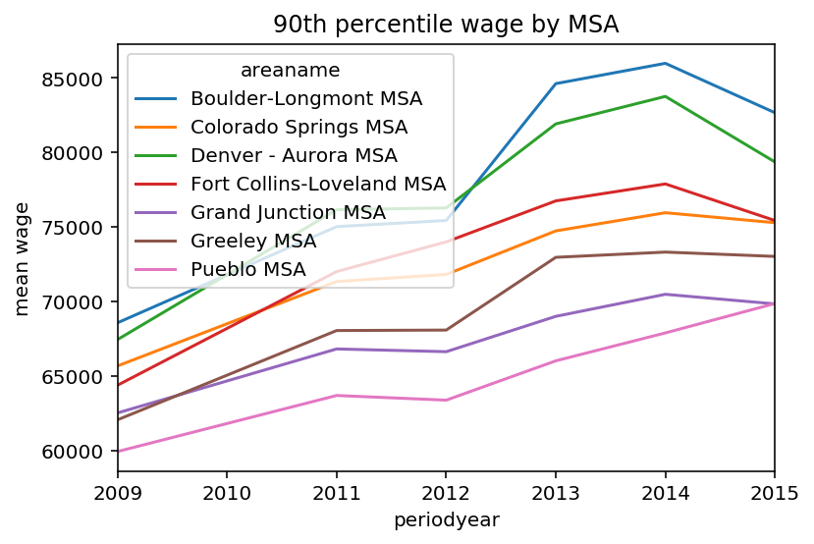
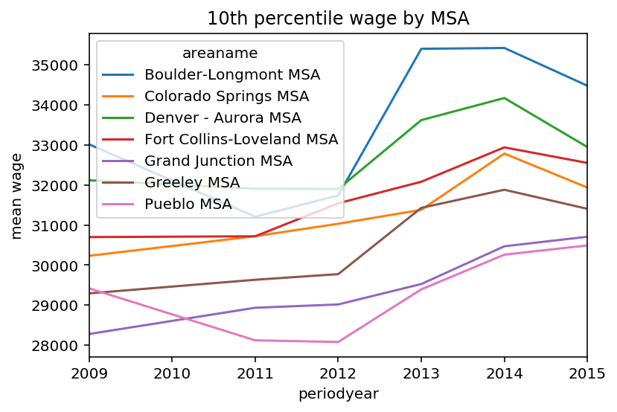
The change in wage over time is different depending on what income bracket you are in
Lower earners experienced a far more difficult revoery after the recession. High wage earners seemed to revocer quickly
In 2012 The gap between the mean 90th percentile in the wealthiest MSA and the poorest MSA in Colorado was $50,00 per year or 177%

Slide 14
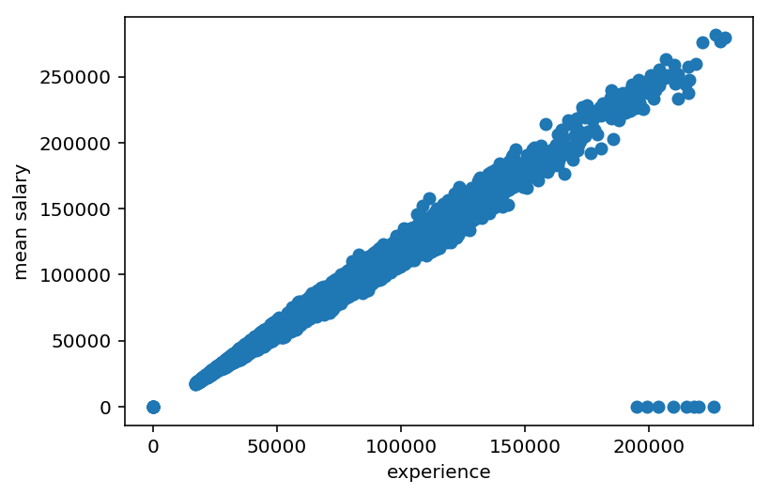
Experience has the strongest positive correlation with mean wage

Slide 15
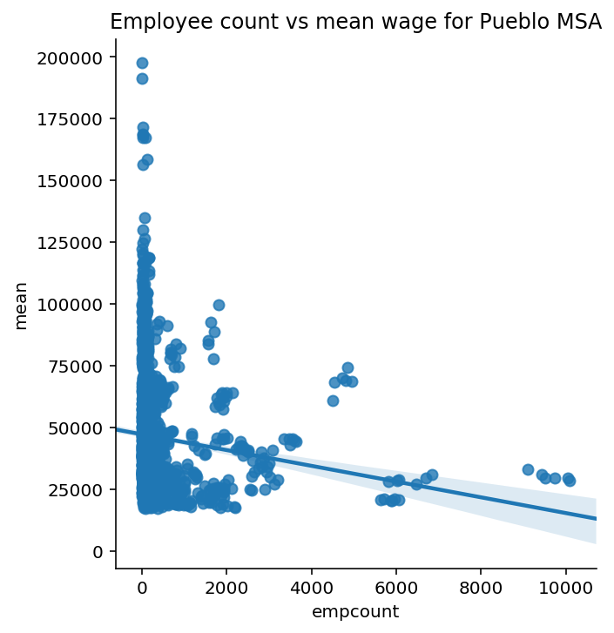
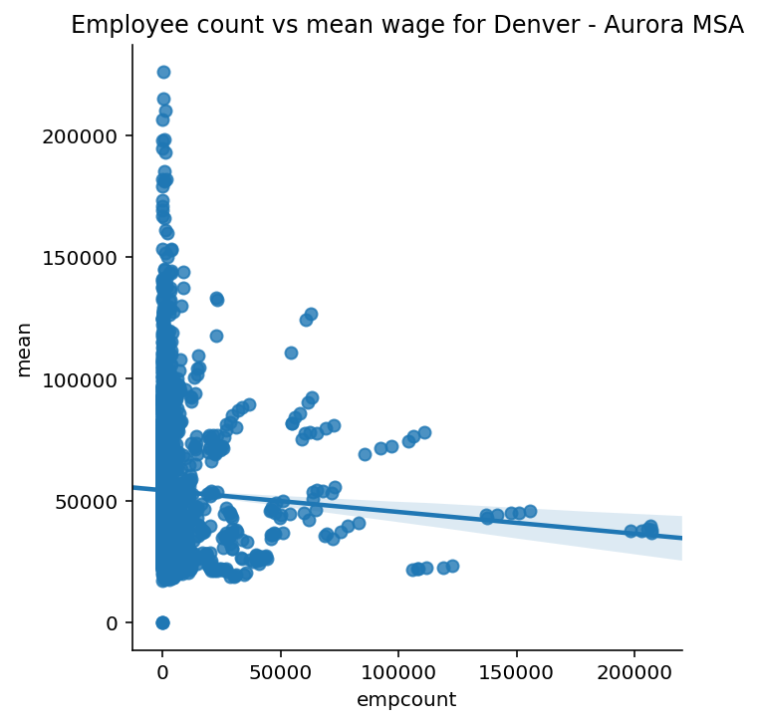
Contrasting the Largest and smallest MSA according to population count
We see a similar trend but the wage for more common jobs is much lower in Pueblo

Slide 16
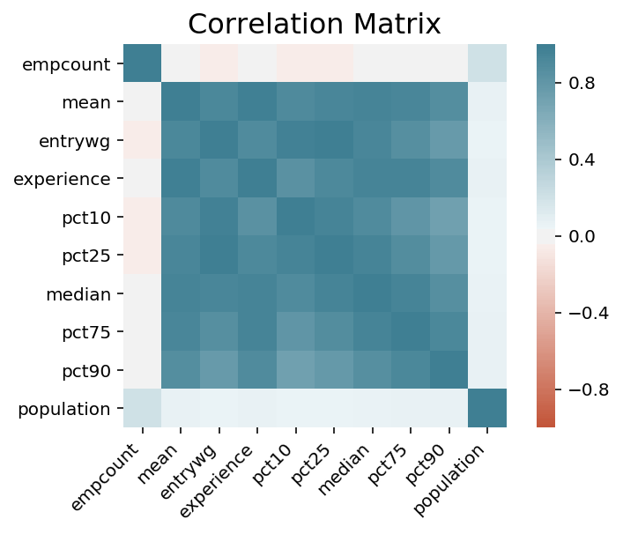
Different regression models were used to see if we could estimate wages given our variables
Column | Description
mean | Mean wage for the occupation.
entrywg | Entry level wage for the occupation, mean of the first third (ALC definition).
experience | Experienced level wage for the occupation, mean of upper two thirds (ALC definition).
pct10 | Wage at tenth percentile.
pct25 | Wage at twenty-fifth percentile.
median | Median wage of the occupation; also the wage at fiftieth percentile.
pct75 | Wage at seventy-fifth percentile.
pct90 | Wage at ninetieth percentile.
population | Number representing the population total for the specified geographic area and time period.

Slide 17
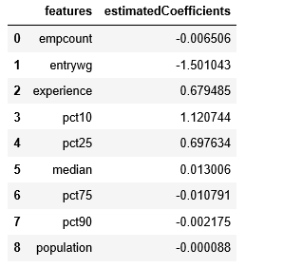
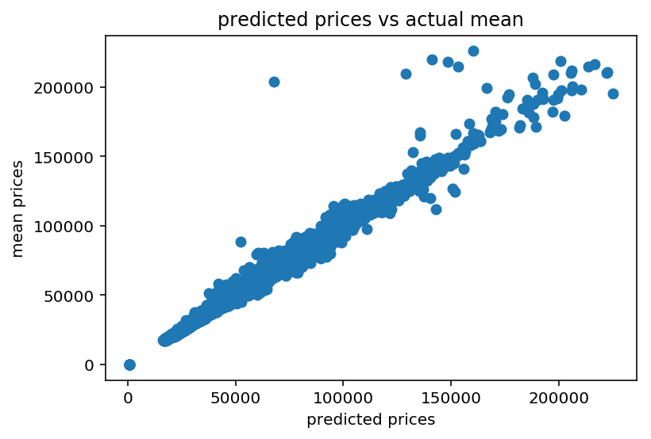
With a predicted intercept 963.56 it looks like we had a model that had a high accuracy when predicting prices

Slide 18
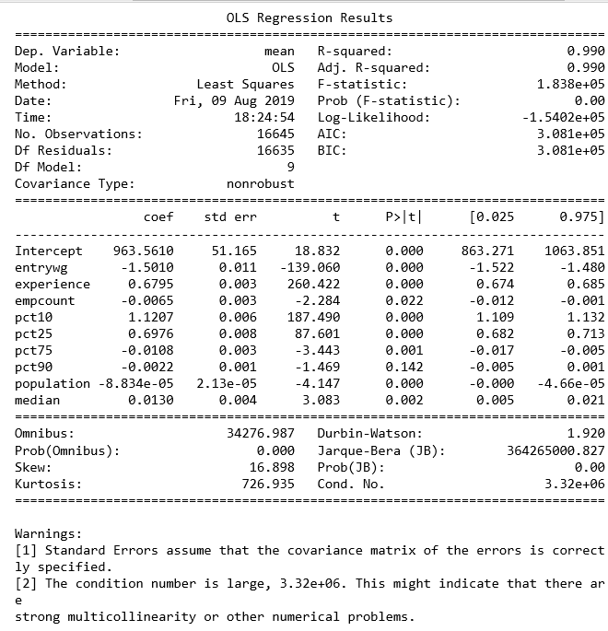
Using OLS method we saw there might be issues with overfitting
High R^2
Skew and Kurtosis levels
Multicollinearity issues

Slide 19
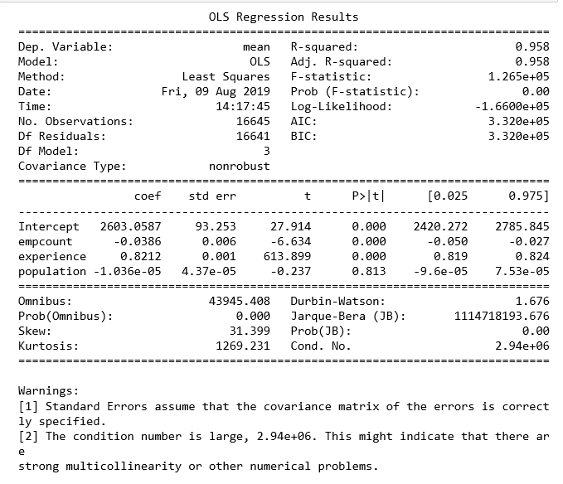
We removed
Slightly lower R^2
Skew and Kurtosis levels increased
Multicollinearity issues persist

Slide 21
Unsupervised Learning

Slide 22
Logistic regression was used to train and test data, but we still have some issues:
With experience included we see an r^2 of .48. With experience removed the r^2 increases to .66 indicating that the generalizability of the model with experience added is lower. The overfitting was slightly improved, but we are able to conclude that more variables should be considered when attempting to predict mean wage. Further exploration of factors like population density, housing prices, crime rates, average employee age and other standard of living metrics should be performed to improve this model.

Slide 23
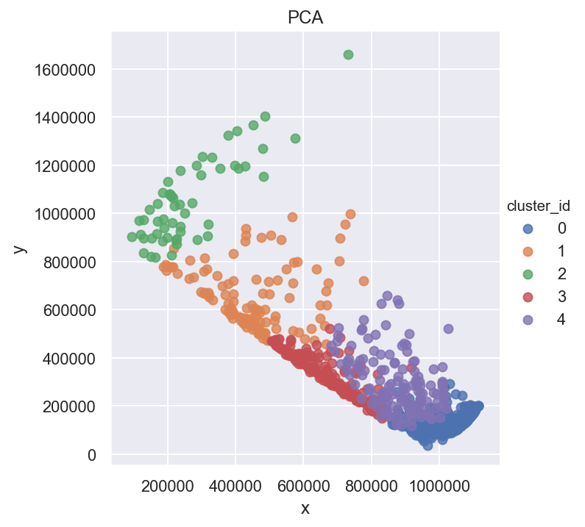
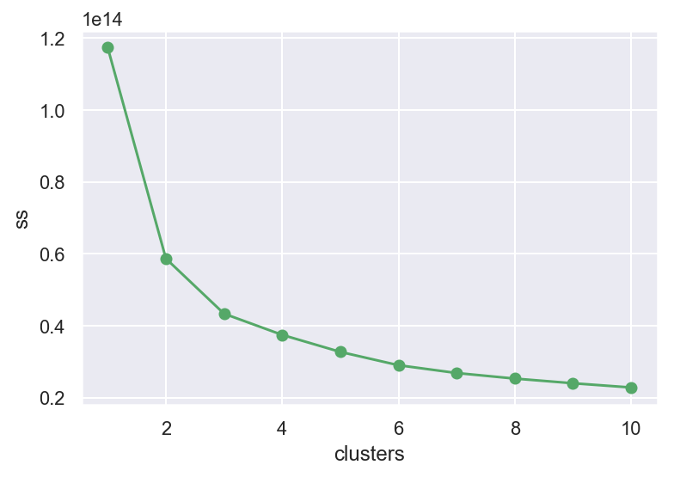
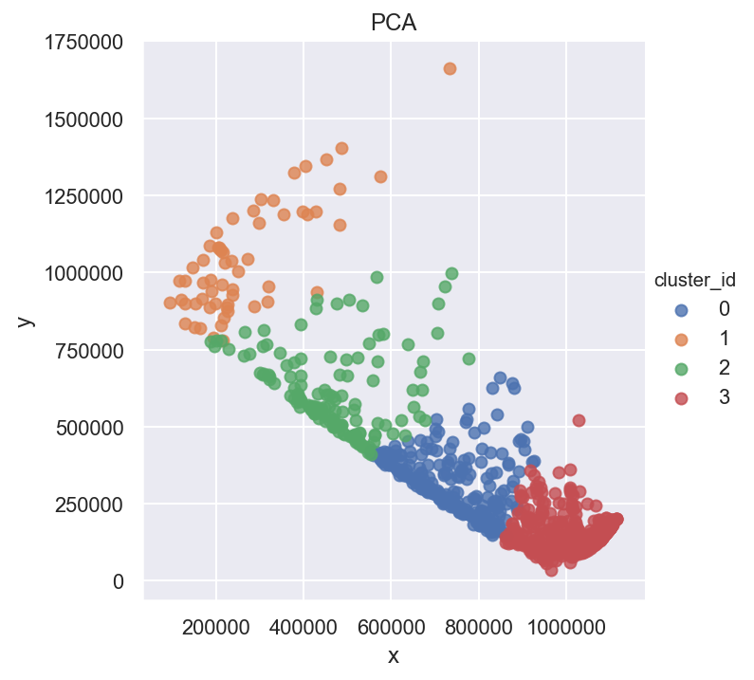
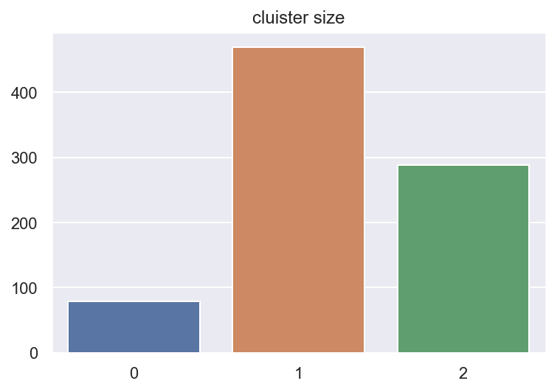
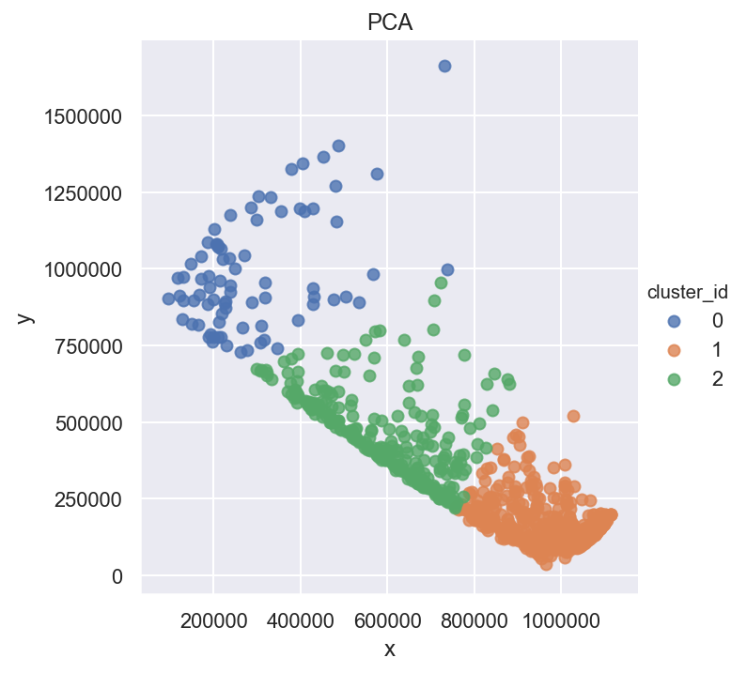
K-means and PCA was used to find clusters 3 was decided upon
3
2
5
4
1
Elbow indicated at 3
2
3
1
4
1
3
2

Slide 24
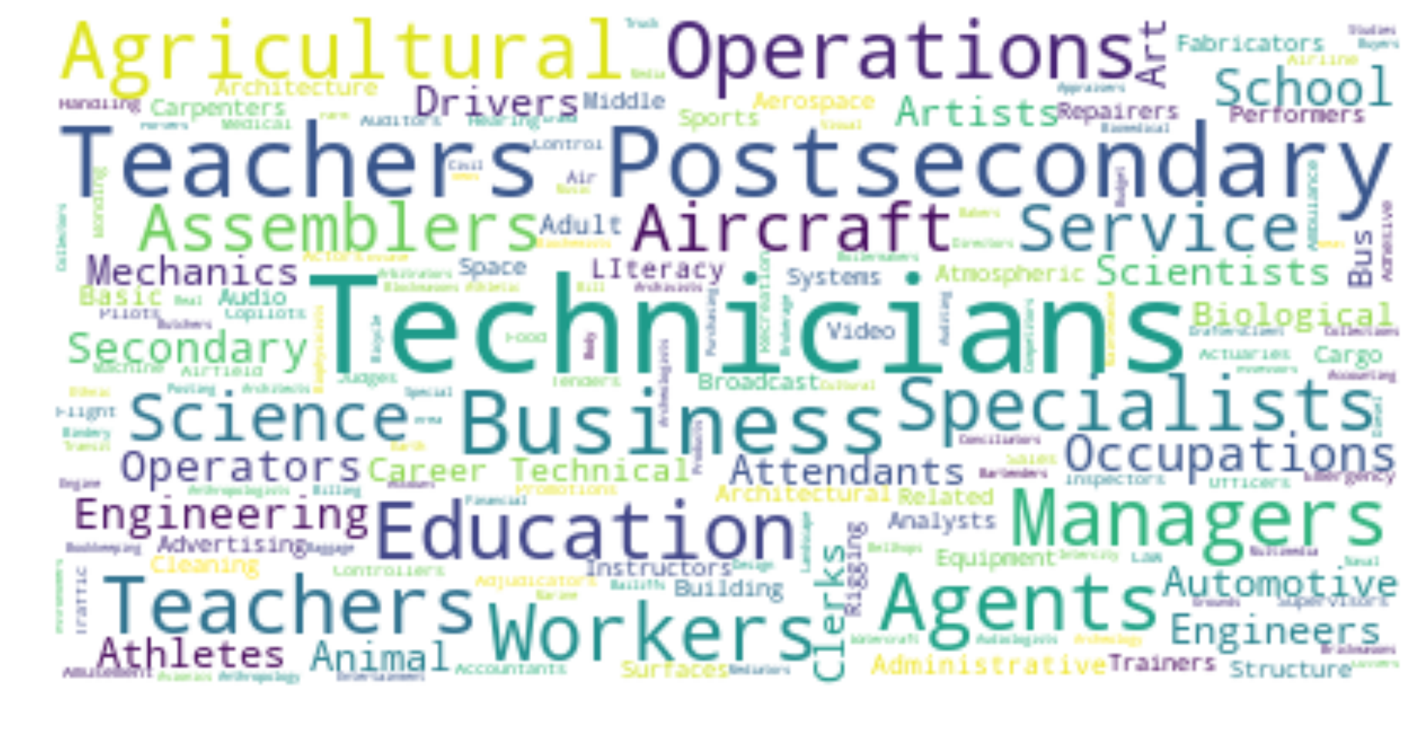
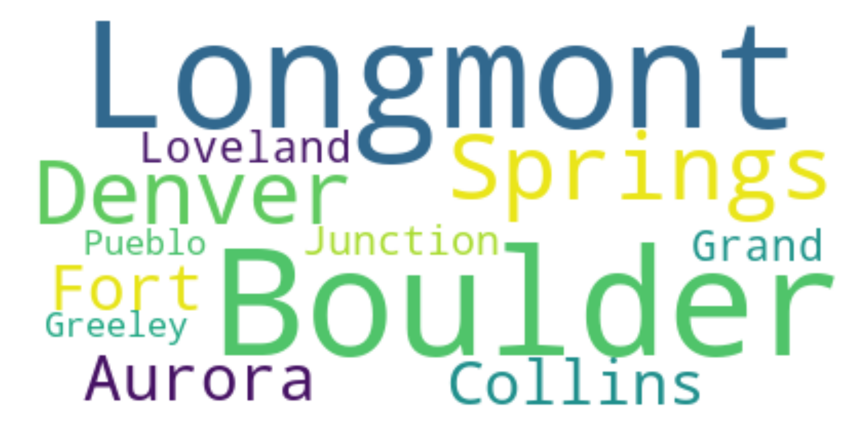
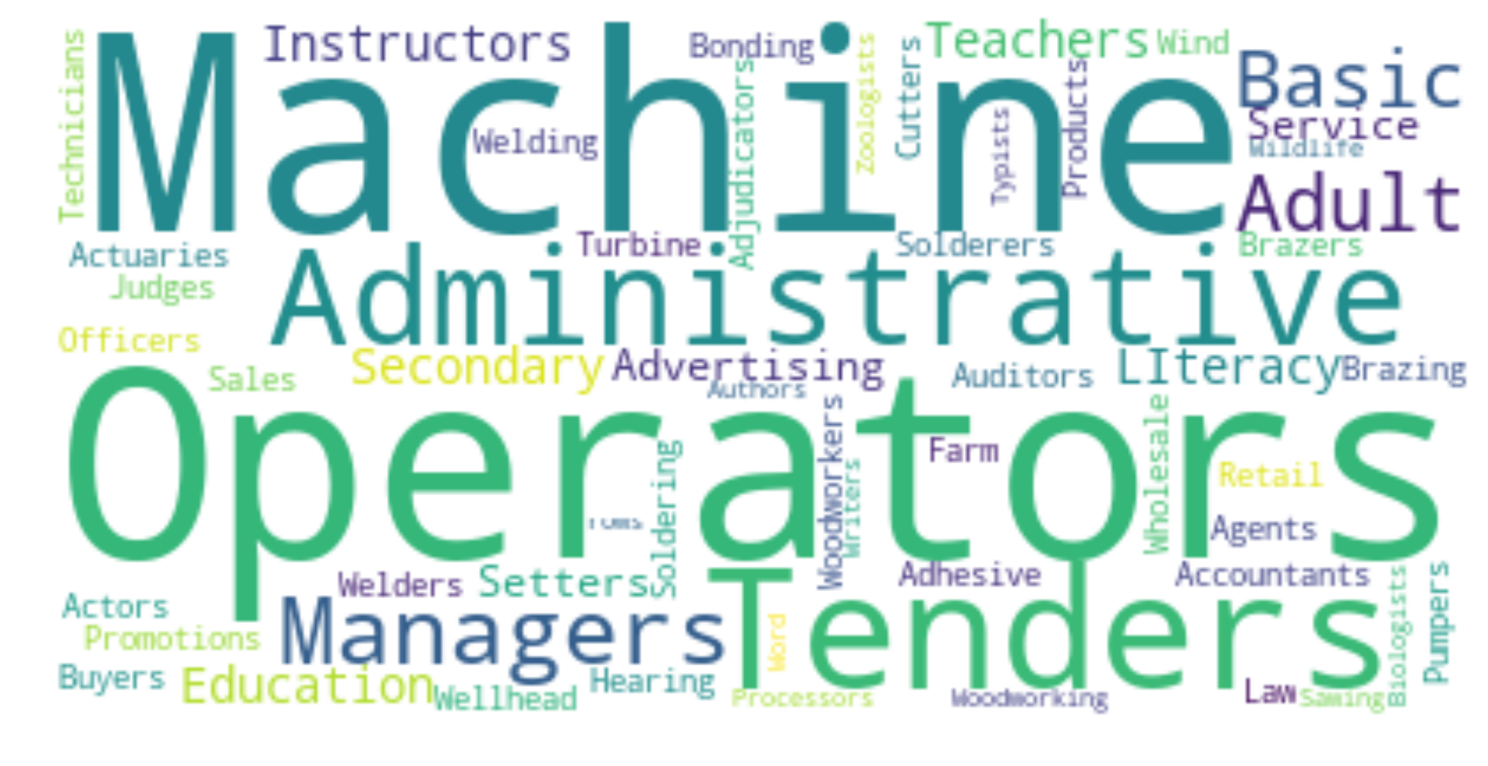
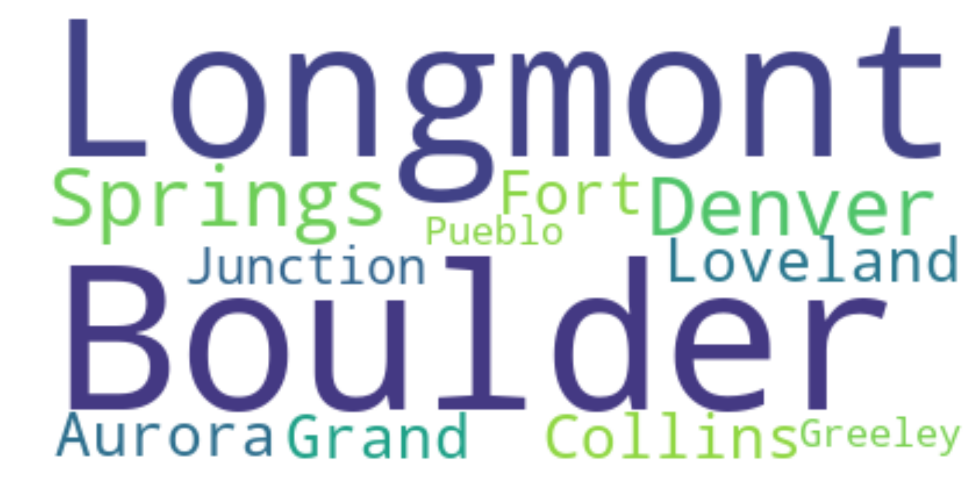
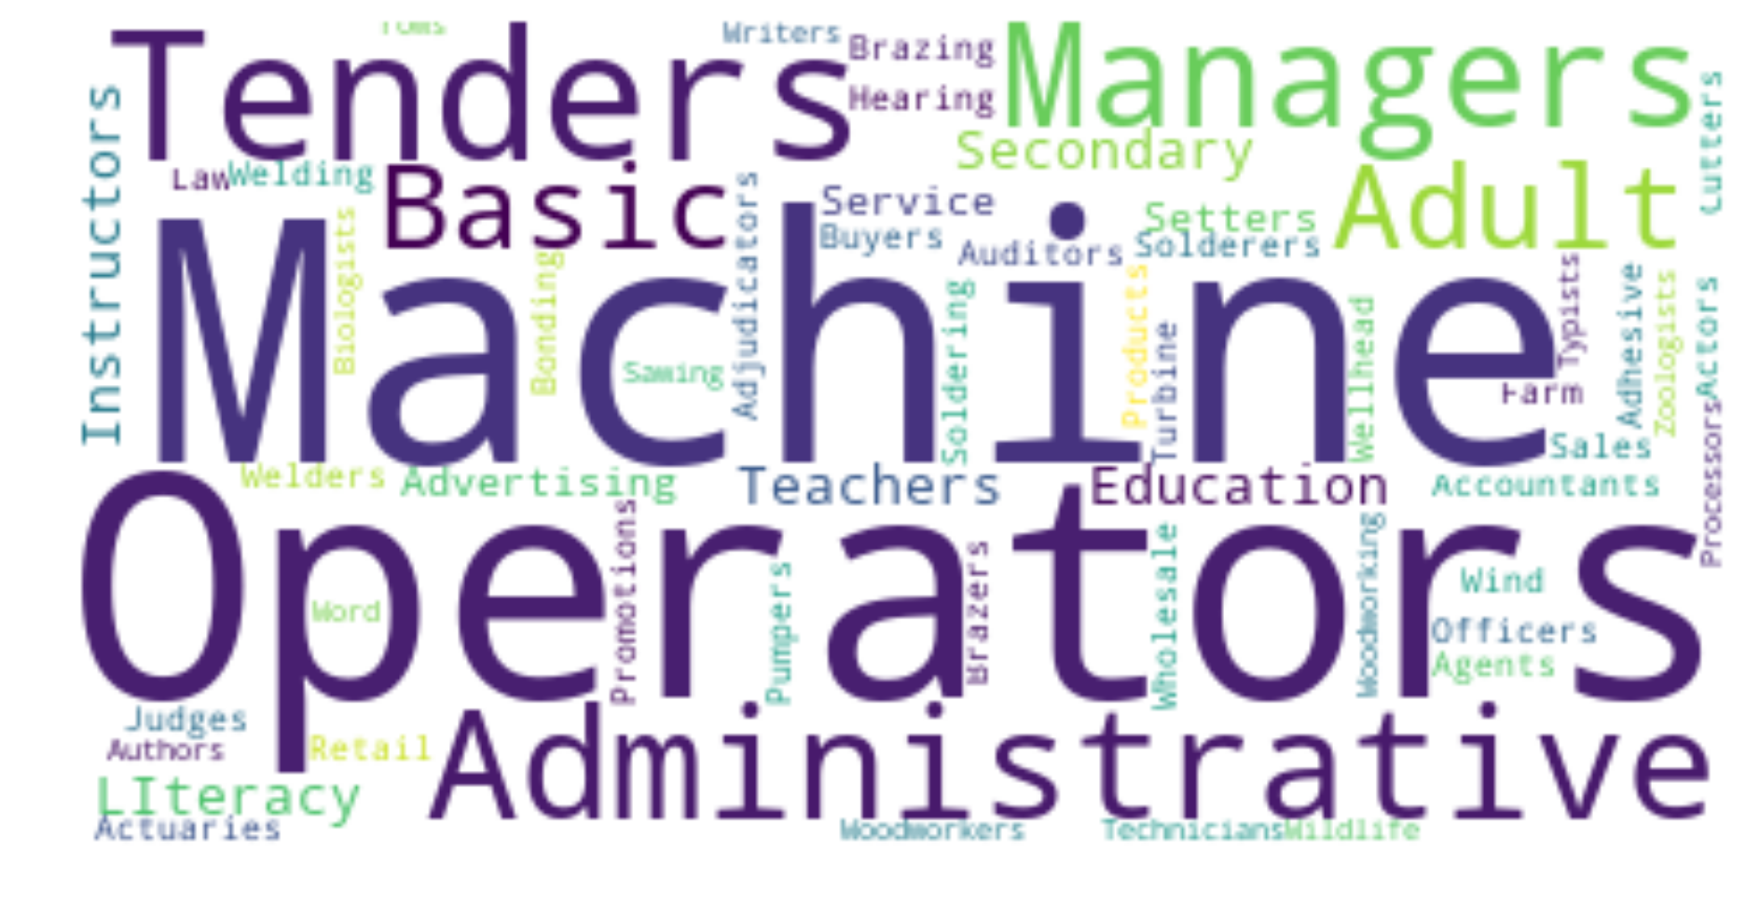
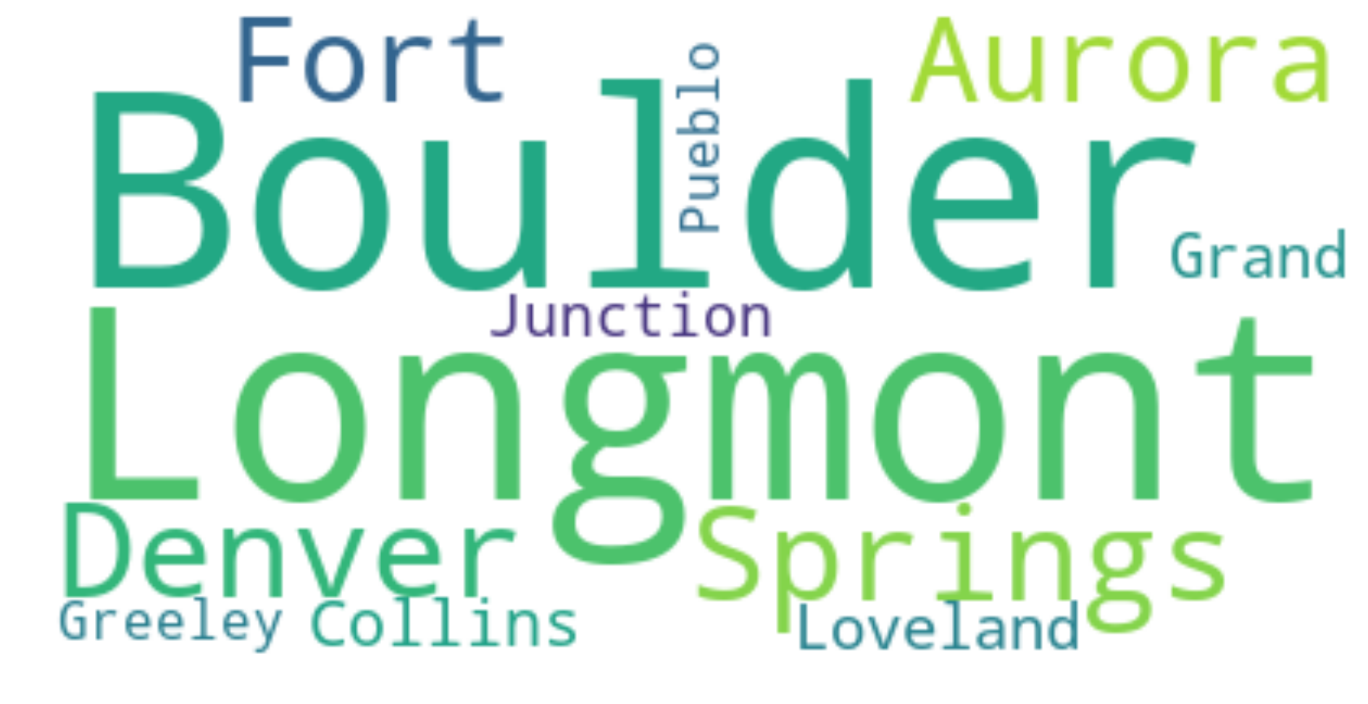
With 3 clusters word clouds were used to see if there was commonalities. Adjusted slightly for weight
Code title Occupation
Area name (MSA)
1
2
3

Slide 25
Cluster 1 is more specialty based and urban
Code title Occupation
Area name (MSA)
1
Cluster 2 is technical, trade based, and managerial
2
Cluster 3 seems more working class and small town based
3

Slide 26
Assumptions and Limitations
The Colorado Datasets had some missing information by year so it will be weighted heavily against jobs that have 2009-2015 filled out completely.
The data had very few variables to analyze in a meaningful manner for regression. They were either too un-correlated or too strongly correlated to the point where it caused overfitting.
Boulder being the highest PHD per capita location in the US could have a significant skewing factor on the data for wages. It is likely that other low population cities such as that would be weighted towards a high wage. This may be an outlier across the US
Certain areas of Colorado have significant oil subsidies. Compared to a lot of the rural US there is a decent job market in less populated areas

Slide 27
Recommendations and Future work
Some analysis on standard of living would be a much more reasonable way to analyze the data, as that may have features that can be generalized across the US
Closer analysis on neighborhoods in Denver could tell a more interesting story. Aurora has lowest educated rates in Colorado, and is ranked quite low in the US, but was grouped in with Denver. An analysis and comparison of Aurora on it’s own, being an urban and lower income location would be interesting in contrast to Boulder
There are a bunch of counties that were not included in the overall employment data. Some of the most rural parts of Colorado are left out of analysis. Additionally, Pitkin County includes Aspen which is one of the wealthiest areas in the country, which was also not included in the Colorado websites data
Usable industry codes would have also grouped the data more naturally. Fewer industries would have been more easy to manage than 850 unique occupations

Slide 28
Conclusions
Given the data and variables that I was provided, it is insufficient to build a model of expected wages, simply on population, employee count, and experience alone. More research needs to be done on education levels of an area and other standard of living metrics
Despite the limitations we can conclude that Boulder, and Denver perform quite well and increased significantly in wage growth over the last few years as an average
Bottom 10th percentile see a significant lag in wage growth in comparison to the top 90th and even the mean. They seemed to struggle the worst from the recession even in a part of the country that has strong industries and available jobs.
Experience is an extremely strong indicator of wage, more information needs to be addressed to see how true that is across all industries. In most cases being very experienced at one occupation can lead to a higher wage.

